Slide 2
The Second Sign
(John 4:43-54 NIV)

Slide 3
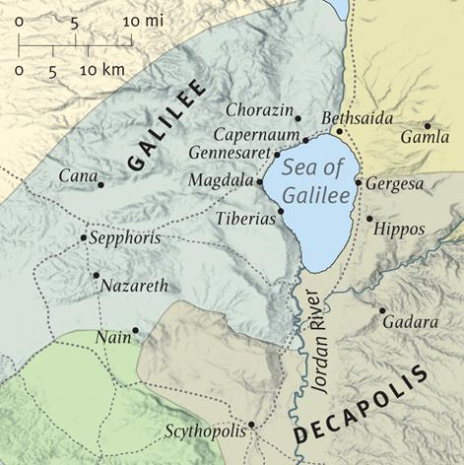
The Second Sign
Traveling from Sychar
Coming from Sychar after ‘the woman at the well’
Last time in Cana: Thirsty Wedding Banquet

Slide 4
The Second Sign
⁴³ After the two days he left for Galilee. ⁴⁴ (Now Jesus himself had pointed out that a prophet has no honor in his own country.) ⁴⁵ When he arrived in Galilee, the Galileans welcomed him. They had seen all that he had done in Jerusalem at the Passover Festival, for they also had been there.

Slide 5
The Second Sign
Crisis Faith
⁴⁶ Once more he visited Cana in Galilee, where he had turned the water into wine. And there was a certain royal official whose son lay sick at Capernaum. ⁴⁷ When this man heard that Jesus had arrived in Galilee from Judea, he went to him and begged him to come and heal his son, who was close to death.

Slide 6
Traveling from Sychar
20 mi from Cana

Slide 7
The Second Sign
Confident Faith
⁴⁸ “Unless you people see signs and wonders,” Jesus told him, “you will never believe.” ⁴⁹ The royal official said, “Sir, come down before my child dies.” ⁵⁰ “Go,” Jesus replied, “your son will live.” The man took Jesus at his word and departed.

Slide 8
The Second Sign
Confirmed Faith
⁵¹ While he was still on the way, his servants met him with the news that his boy was living. ⁵² When he inquired as to the time when his son got better, they said to him, “Yesterday, at one in the afternoon, the fever left him.

Slide 9
The Second Sign
Contagious Faith
⁵³ Then the father realized that this was the exact time at which Jesus had said to him, “Your son will live.” So he and his whole household believed. ⁵⁴ This was the second sign Jesus performed after coming from Judea to Galilee.
John 4:43-54 NIV

Slide 10
The Second Sign
Crisis Faith
Confident Faith
Confirmed Faith
Contagious Faith

Slide 11
Communion

