Slide 2
A Revelation Of
A Revelation
(Daniel 2:24-49 NIV)

Slide 3
A Revelation Of
A Revelation
A Declaration To Save All
²⁴Then Daniel went to Arioch, whom the king had appointed to execute the wise men of Babylon, and said to him, “Do not execute the wise men of Babylon. Take me to the king, and I will interpret his dream for him.”

Slide 4
A Revelation Of
A Revelation
A Declaration To Save All
²⁵Arioch took Daniel to the king at once and said, “I have found a man among the exiles from Judah who can tell the king what his dream means.”

Slide 5
A Revelation Of
A Revelation
Only The God Of Israel
²⁶The king asked Daniel (also called Belteshazzar), “Are you able to tell me what I saw in my dream and interpret it?”

Slide 6
A Revelation Of
A Revelation
Only The God Of Israel
²⁷Daniel replied, “No wise man, enchanter, magician or diviner can explain to the king the mystery he has asked about, ²⁸but there is a God in heaven who reveals mysteries. He has shown King Nebuchadnezzar what will happen in days to come.

Slide 7
A Revelation Of
A Revelation
Only The God Of Israel
Your dream and the visions that passed through your mind as you were lying in bed are these:

Slide 8
A Revelation Of
A Revelation
Only The God Of Israel
²⁹“As Your Majesty was lying there, your mind turned to things to come, and the revealer of mysteries showed you what is going to happen.

Slide 9
A Revelation Of
A Revelation
Only The God Of Israel
³⁰As for me, this mystery has been revealed to me, not because I have greater wisdom than anyone else alive, but so that Your Majesty may know the interpretation and that you may understand what went through your mind.

Slide 10
A Revelation Of
A Revelation
The First Miracle
³¹“Your Majesty looked, and there before you stood a large statue—an enormous, dazzling statue, awesome in appearance. ³²The head of the statue was made of pure gold, its chest and arms of silver, its belly and thighs of bronze,

Slide 11
A Revelation Of
A Revelation
The First Miracle
³³its legs of iron, its feet partly of iron and partly of baked clay. ³⁴While you were watching, a rock was cut out, but not by human hands. It struck the statue on its feet of iron and clay and smashed them.

Slide 12
A Revelation Of
A Revelation
The First Miracle
³⁵Then the iron, the clay, the bronze, the silver and the gold were all broken to pieces and became like chaff on a threshing floor in the summer. The wind swept them away without leaving a trace.

Slide 13
A Revelation Of
A Revelation
The First Miracle
But the rock that struck the statue became a huge mountain and filled the whole earth.

Slide 14
A Revelation Of
A Revelation
The Interpretation
³⁶“This was the dream, and now we will interpret it to the king. ³⁷Your Majesty, you are the king of kings. The God of heaven has given you dominion and power and might and glory;

Slide 15
A Revelation Of
A Revelation
The Interpretation
³⁸in your hands he has placed all mankind and the beasts of the field and the birds in the sky. Wherever they live, he has made you ruler over them all. You are that head of gold.
³⁹“After you, another kingdom will arise, inferior to yours.

Slide 16
A Revelation Of
A Revelation
The Interpretation
Next, a third kingdom, one of bronze, will rule over the whole earth. ⁴⁰Finally, there will be a fourth kingdom, strong as iron—for iron breaks and smashes everything—and as iron breaks things to pieces, so it will crush and break all the others.

Slide 17
A Revelation Of
A Revelation
The Interpretation
⁴¹Just as you saw that the feet and toes were partly of baked clay and partly of iron, so this will be a divided kingdom; yet it will have some of the strength of iron in it, even as you saw iron mixed with clay.

Slide 18
A Revelation Of
A Revelation
The Interpretation
⁴²As the toes were partly iron and partly clay, so this kingdom will be partly strong and partly brittle. ⁴³And just as you saw the iron mixed with baked clay, so the people will be a mixture and will not remain united, any more than iron mixes with clay.

Slide 19
A Revelation Of
A Revelation
The Interpretation
⁴⁴“In the time of those kings, the God of heaven will set up a kingdom that will never be destroyed, nor will it be left to another people. It will crush all those kingdoms and bring them to an end, but it will itself endure forever.

Slide 20
A Revelation Of
A Revelation
The Interpretation
⁴⁵This is the meaning of the vision of the rock cut out of a mountain, but not by human hands —a rock that broke the iron, the bronze, the clay, the silver and the gold to pieces.

Slide 21
A Revelation Of
A Revelation
The Interpretation
“The great God has shown the king what will take place in the future. The dream is true and its interpretation is trustworthy.”

Slide 22
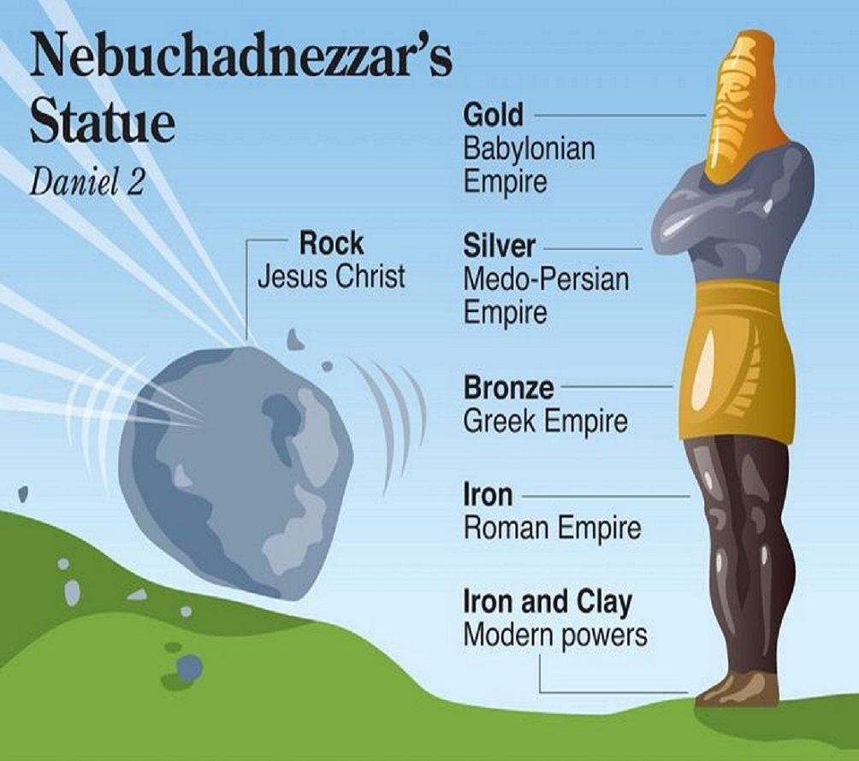
A Revelation Of
A Revelation
Missing The Mark

Slide 23
A Revelation Of
A Revelation
Missing The Mark
⁴⁶Then King Nebuchadnezzar fell prostrate before Daniel and paid him honor and ordered that an offering and incense be presented to him.

Slide 24
A Revelation Of
A Revelation
Missing The Mark
⁴⁷The king said to Daniel, “Surely your God is the God of gods and the Lord of kings and a revealer of mysteries, for you were able to reveal this mystery.”

Slide 25
A Revelation Of
A Revelation
God’s Influencer
⁴⁸Then the king placed Daniel in a high position and lavished many gifts on him. He made him ruler over the entire province of Babylon and placed him in charge of all its wise men.

Slide 26
A Revelation Of
A Revelation
God’s Influencer
⁴⁹Moreover, at Daniel’s request the king appointed Shadrach, Meshach and Abednego administrators over the province of Babylon, while Daniel himself remained at the royal court.

